Slide 1
Learning the Preferences of Ignorant, Inconsistent Agents
Owain Evans (Oxford), Andreas Stuhlmueller (Stanford), Noah Goodman (Stanford)

Slide 2


Learning the Preferences of Ignorant, Inconsistent Agents
Owain Evans (Oxford), Andreas Stuhlmueller (Stanford), Noah Goodman (Stanford)

Slide 3
1. Motivation for learning human preferences
Scientific (economics, psychology): how do people value work vs. leisure, short-term vs. long-term, country vs. friends & family?
Machine learning (applications): recommendation (movie, job, dating), create tailored content.
Machine learning (long-term goal): the more systems understand our preferences, the more they can help us make high stakes decisions in novel circumstances.

Slide 4
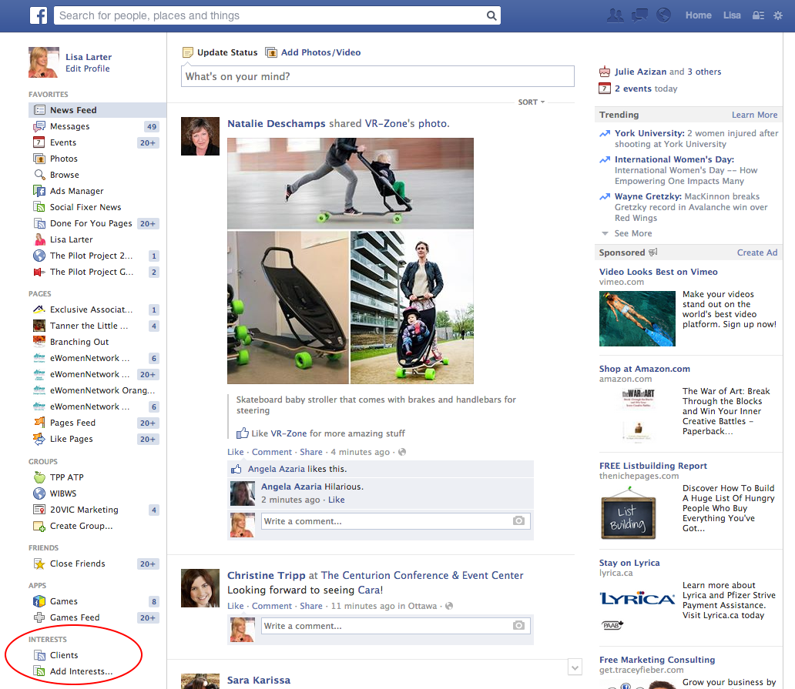
Notes:
Over a billion distinct users seeing FB Newsfeed everyday. Use choices and behavior on FB to select new content for user. Raises the question: is this algorithm giving people what they actually prefer? If so, why would anyone leave FB?

Slide 5
2. Learning preferences with IRL
Inverse Reinforcement Learning (AI) / Structural Estimation (Econ):
Unsupervised learning, assumed model is MDP, POMDP, RL.
Learn from sequences of choices in complex environments (cf. Netflix)
Learn utility/reward function not policy: enduring cause not contingent effects.
People act on their preferences without ability to report them quantitatively (driving skill, detailed vacation plan)

Slide 6
3. The problem of systematic error
IRL: infer preferences from observed actions … assuming human fits (MDP/POMDP) model up to random (softmax) errors.
Notes:
Simple distraction blocker increase completion rate by 40% for Stanford online stats class. Problem extends beyond IRL: if choices fail to efficiently realize preferences, then hard to learn from them without additional assumptions.

Slide 7
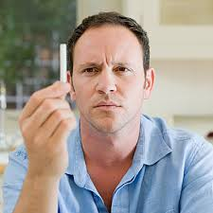
3. The problem of systematic error
IRL: infer preferences from observed actions … assuming human fits (MDP/POMDP) model up to random (softmax) errors.
But human make systematic errors! Person smokes every day but regrets it.
Notes:
Simple distraction blocker increase completion rate by 40% for Stanford online stats class. Problem extends beyond IRL: if choices fail to efficiently realize preferences, then hard to learn from them without additional assumptions.

Slide 8
3. The problem of systematic error
IRL: infer preferences from observed actions … assuming human fits (MDP/POMDP) model up to random (softmax) errors.
But human make systematic errors! Person smokes every day but regrets it.
Behavioral economics (hyperbolic discounting, Prospect Theory)
Bounded cognition (forgetting, limited computational ability, etc.)
Notes:
Simple distraction blocker increase completion rate by 40% for Stanford online stats class. Problem extends beyond IRL: if choices fail to efficiently realize preferences, then hard to learn from them without additional assumptions.

Slide 9
4. Learning from ignorant, inconsistent agents
Our approach:
build flexible generative models to capture a range of biases and cognitive bounds (while maintaining tractability)
jointly infer biases (or lack thereof) and preferences from behavior
if successful, can help humans overcome biases

Slide 10
5. Human bias: Time inconsistency
Intuition: tonight you want to rise early but tomorrow you want to sleep in.
Most prominent bias: addiction, procrastination, impulsiveness, will-power / pre-commitment.
Formally, any non-exponential discounting implies time-inconsistency.

Slide 11
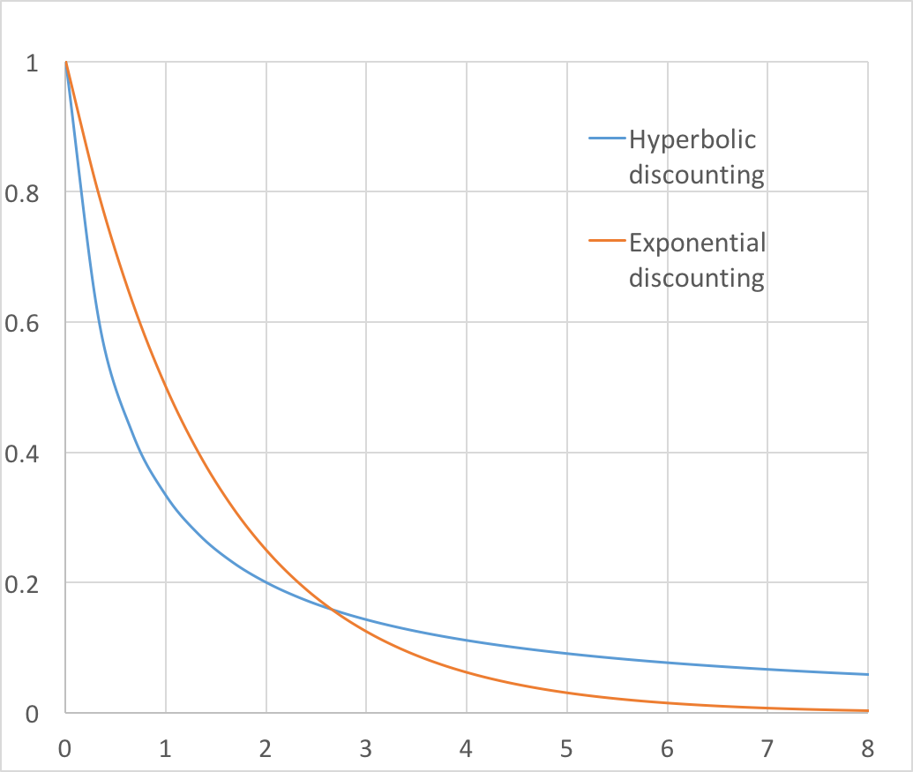
5. Human bias: Time inconsistency
Hyperbolic discounting
Discount factor = 1/(1+kt)
At t=0, you prefer $80 at t=8 to $70 at t=7 (curve shallow)
At t=7, you re-evaluate and prefer $70 now to $80 tomorrow (curve steep).

Slide 12
Discount factor
Days from present

Slide 13
Discount factor
U0-–U1 = 0.5 U1/U0 = 0.5
U0–U1 = 0.67 U1/U0 = 0.33
Curve is STEEP
Curve is FLAT
U5—U4 = 0.02 U5/U4 = 0.81
U5—U4 = 0.03 U5/U4 = 0.5
Days from present

Slide 14
5. Model for biased agent
MDP model:
MDP + Hyberbolic discounting (variable d for “delay” measures how far in the future the action a would take place):

Slide 15
6. Goal for examples and experiments
Show that ignoring biases (assuming optimality) leads to mistakes in learning preferences
Mistakes occur in simple, uncontrived, everyday scenarios.

Slide 16
 |  |  |  | Donut North
Donut South
Vegetarian Salad Bar
Donut Chain Store
Noodle Shop
Bob eats here
Bob’s starting point
Notes:
Shows Bob’s path. What do we infer? Bob went towards healthy restaurant but then went to Donut place. Time consistent agent would not do this – would go to closer place if preferred donuts. What about this? Next…

Slide 17
 |  |  |  | Donut North
Donut South
Vegetarian Salad Bar
Donut Chain Store
Noodle Shop
Bob eats here
Bob’s starting point
Notes:
Agent still goes to veg but avoids temptation. Time consistent would not. But need to be predict you’ll be tempted : SOPH vs. NAÏVE.

Slide 18
5. Model for biased agent - NAIVE
MDP model:
MDP + Hyberbolic discounting (variable d for “delay” measures how far in the future the action a would take place):

Slide 19
5. Model for biased agent - SOPHISTICATED
MDP model:
MDP + Hyberbolic discounting (variable d for “delay” measures how far in the future the action a would take place):

Slide 20
Notes:
We can infer: Agent has preference for veg, agent discount rate, whether agent naive or sophisticated. Posteriors spread out coz can’t identify much.

Slide 21
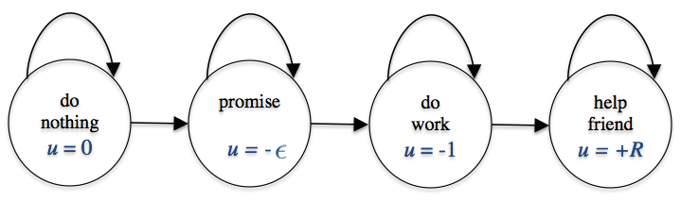
6. Model for biases agent: Procrastination
Notes:
You promise a friend you’ll help with a paper but you know it’s hard and tedious work. Deadline is 10 days away. On first day, you say you’ll do it tomorrow. On second day, you say you’ll do it tomorrow. You know that better for friend to get comments earlier. So every delay makes things worse.

Slide 22
6. Model for biased agent: Procrastination
Inferred value of helping friend
Notes:
If you assume optimal agent, then for every day you delay, we infer you care less and less about friend (to zero). Our model includes both optimal and discounting agents. Here, we don’t infer you don’t care at all about friend – you could just be a procrastinator.

Slide 23
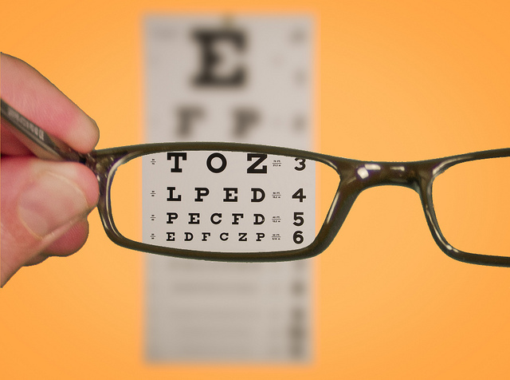
7. Model for biased agent: Myopia
Simple myopia (near sighted): ignore any rewards or costs after time k1 > 0 (even though you’ll still be alive).
Bounded Value-of-Information: ignore the value of information gained after time k2 > 0 (even though you will still get benefits from information).

Slide 24
7. Model for biased agent: Myopia
Notes:
Test on Bandit Problems where we don’t know the utility the agent gets from arms. Myopia agents place less value on exploration. If you assume they are optimal, you infer they have such a strong preference for one arm that they don’t bother exploring. Our model does not make this inference: it has alternative explanation.

